Slide 1
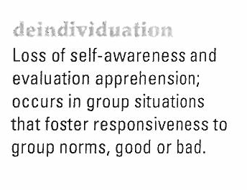
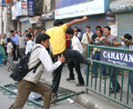
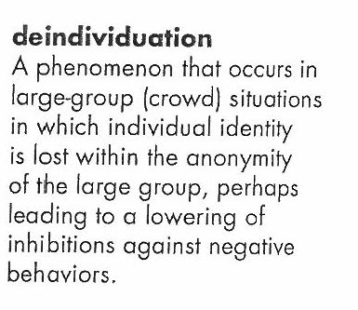
Deindividuation
Mob behavior

Slide 2
EFFECTS OF THE PRESENCE OF OTHERS
Deindividuation—characterised by reduced self-awareness and reduced social identity, brought on by external conditions such as being an anonymous member of a large crowd. Deindividuation results in an increase in the tendency to follow the norms of the group (the crowd), which can result in negative or positive behaviours. As well as results in behaviors that individuals in the group often would not perform by themselves
Deindividuation is similar to the notion of ‘diminished responsibility’. A crowd’s behaviour is seen to be due to the loss of personal identity that occurs when we are in a crowd; we become ‘faceless’ and anonymous (i.e., deindividuated). This anonymity means we feel less constrained by the norms (see glossary) of social behaviour and more able to behave anti-socially; the fear of being ‘caught’ and the guilt of such antisocial behaviour decreases.
Notes:
13
12
4

Slide 3
DEINDIVIDUATION IN ACTION
Throughout history, there have been many examples of groups of people committing horrendous acts that no individual would do on his/her own. And the savagery of the act is related to the size of the group (Mullen, 1986). Mullen analyzed news reports of lynchings in the U.S. from 1899-1946 and found that the larger the mob, the greater the savagery with which they killed their victims.
In 1964, a man standing on the ledge of a ten-storey building was baited by a crowd of 500 people to jump. When rescued, the crowd jeered. Mann (1981) recorded ten similar real-life instances of baiting mob behaviour. Mann (1981) argues that the people in the ‘baiting’ crowd are deindividuated.

Slide 4
WHY IS IT DEINDIVIDUATION LEADS TO IMPULSIVE (OFTEN VIOLENT) ACTS?
Two factors are involved:
i) The presence of others, or the wearing of uniforms and disguises makes people feel less accountable for their actions, because it reduces the likelihood that any individual will be singled out and blamed.
The presence of others lowers self-awareness, thereby shifting people’s attention away from their moral standards.
Note: Even the colour of a uniform can make a difference in the amount of aggression expressed by the group. Black is associated with evil and death, and with greater aggressiveness by sporting teams (Frank & Gilovich, 1988).
© 2004 Pearson Education Canada Inc.

Slide 5
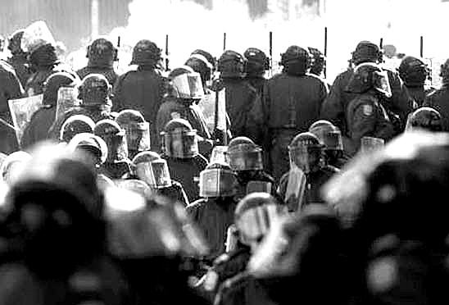
FACTORS THAT INFLUENCE DEINDIVIDUATION
1. Group size
Large Group
Small Group
More
deindividuation

Slide 6
FACTORS THAT INFLUENCE DEINDIVIDUATION
2. Accountability
High
Accountability
Low
Accountability
More
deindividuation

Slide 7
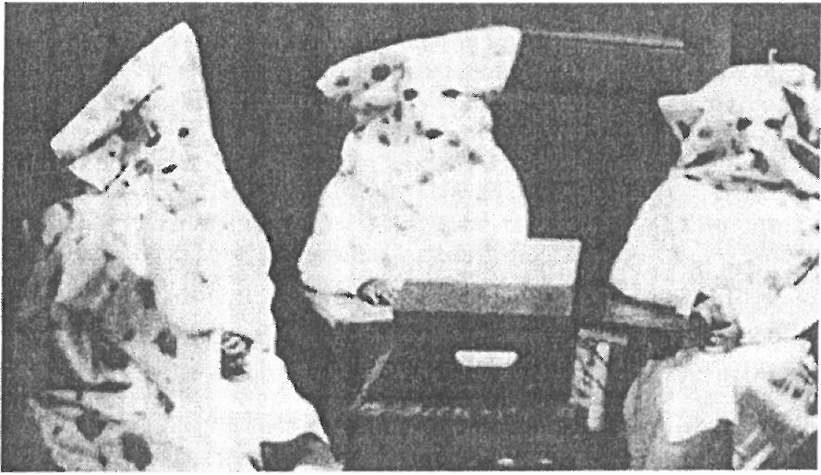
FACTORS THAT INFLUENCE DEINDIVIDUATION
3. Anonymity
Not
Anonymous
Anonymous
More
deindividuation

Slide 8
ANONYMITY STUDY
ZIMBARDO (1970)
Not
Anonymous
Anonymous
Coats – Hoods
Normal Clothes
Name Tags
Gave 2 times
more shock
cp
Notes:
http://www.youtube.com/watch?v=IhpxwJCXInM
This study prompted Zimbardo to write his initial theory and model of deindividuation based on the results of his research. In one study, participants in the experimental condition were made to be anonymous by being issued large coats and hoods which largely concealed their identity.
These New York University women were dressed up like Ku Klux Klan members. In contrast, the participants in the control condition wore normal clothes and name tags. Each participant was brought into a room and given the task of “shocking” a confederate in another room at different levels of severity ranging from mild to dangerous (similar to Stanley Milgram’s study in 1963.)
Zimbardo noted that participants who were in the anonymous condition “shocked” the confederates longer, which would have caused more pain in a real situation, than those in the non-anonymous control group. This study motivated Zimbardo to examine this deindividuation and aggression in a prison setting, which is discussed in the next study listed.

Slide 9
SUMMING UP:
When high levels of social arousal combine with diffused responsibility, people may abandon their normal restraints and lose their sense of individuality.
Such deindividuation is especially likely when people are in a large group, are physically anonymous, and are aroused and distracted.
The resulting diminished self-awareness and self-restraint tend to increase peoples responsiveness to the immediate situation, be it negative or positive. Deindividuation is less likely when self awareness is high

Slide 10
TO DO:
Read textbook: page 111. Summarise information on deindividuation.
Complete case study handout in pairs.

